Slide 1



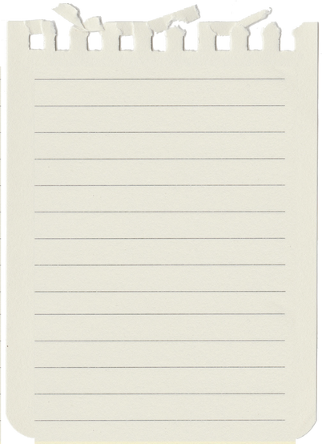

DigiNote
DigiNote
Digitize your notes with DigiNote
PRESENTED TO
PRESENTED BY
Bangkit Academy 2023
C23-PC665

Slide 2

Delivered By
A346DKX4020
C038DSX3069
C151DSX2621
M309DSX3115
M153DSX2790
FATHIR FATHAN
DAVID NABABAN
ADMIRAL HISYAM ZIDNY
RIZKY SANJAYA TANDIA
GILANG MONTANA
UNIVERSITAS SRIWIJAYA MD
INSTITUT TEKNOLOGI SEPULUH NOPEMBER CC
UNIVERSITAS BRAWIJAYA CC
UNIVERSITAS PENDIDIKAN INDONESIA ML
UNIVERSITAS BUDI LUHUR ML

Slide 3
Our Capstone team
We are a five-person team consisting of 1 Android developer, 2 cloud engineers, and 2 machine learning (ML) engineers. The Android developer is responsible for implementing the UI’s app and features, such as create, read, update, delete, image capture, image upload, API access, and the search feature.
Cloud engineers are responsible for creating the REST API with Node.js and Express.js, setting up a cloud environment in Google Cloud Platform, making instances of App Engine to deploy the API, Cloud SQL to store data such as users and notes data, and Cloud Run to deploy the ML model.
ML engineers are responsible for building a model for handwriting recognition using CNN, Bi-RNN, and CTC in TensorFlow for OCR, complemented with preprocessing efforts by image thresholding, page detection, word detection, line segmentation, and creating an API endpoint for access.
Member’s Name
Android Developer:
Fathir Fathan
Cloud Engineers:
David Nababan
Admiral Hisyam Zidny
ML Engineers:
Rizky Sanjaya Tandia
Gilang Montana
18

Slide 4
Capstone Project Intro
This capstone project was decided in a brainstorming session, in which every one of us gave some ideas about problems that we can tackle in the real world, and then from those ideas, there is one that, as students, every one of us can relate to. That is how inconvenient it is to store physical notes, to handle paper degeneration, and to search for a note with particular content from a pile of note papers.
The advantage that our capstone project gives lies in its tangible, real-life usage. It removes any need for storage to store the notes, is durable as long as the database is up, gives less fear of damaging or losing notes, is accessible from any Android device, and eliminates the need to retype the note.
21

Slide 5
Backgrounder
Similiar solutions missing key takeaways
Low Accuracy when it comes to OCR model
More designed to recognize per words instead of sentences
Focused on specific handwriting styles
Focused on particular language
Our goal is to provide users with the advantages of enhanced organization, searchability, and accessibility that come with digital notes.
Ultimately, our project seeks to support improved learning outcomes and productivity by digitizing handwritten notes and leveraging the power of OCR technology.
20

Slide 6

Purpose-driven
DigiNote is designed to meet the needs and convenience for the purpose of converting handwritten text into digital text. Many individuals and organizations often face the need to convert handwritten notes, documents, or other forms of handwritten text into a digital format. DigiNote provides an easy and efficient solution to meet this need, allowing users to easily access, edit, and utilize the converted text for various purposes such as editing, sharing, or organizing.
DigiNote helps them perform these tasks quickly, efficiently, easily, and accurately. Thus, our solution has strong opportunities in these specific purposes and adds meaningful value to our target market.
20
Purpose-driven

Slide 7
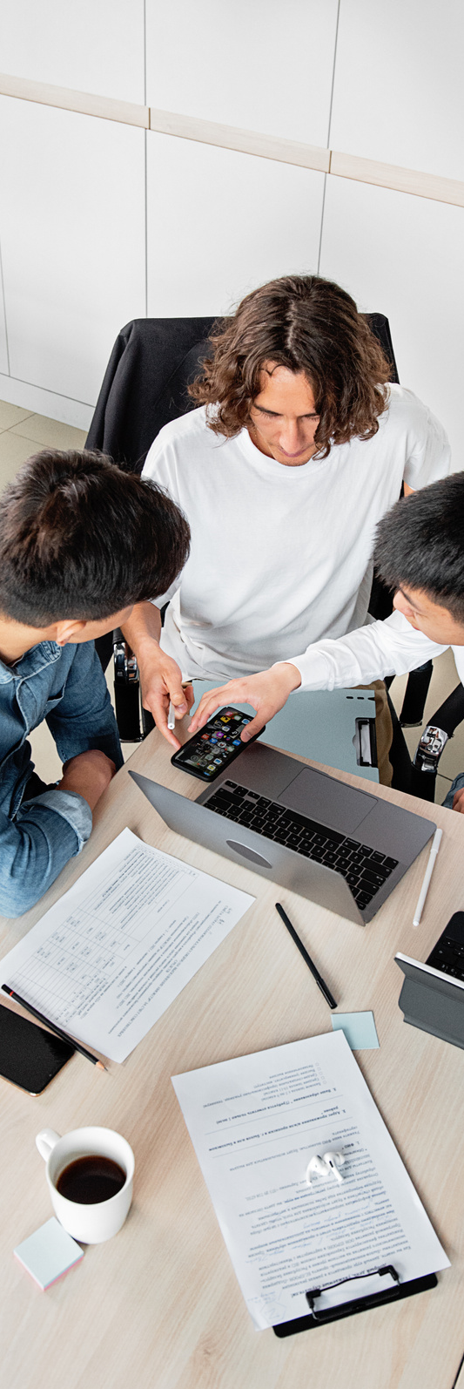
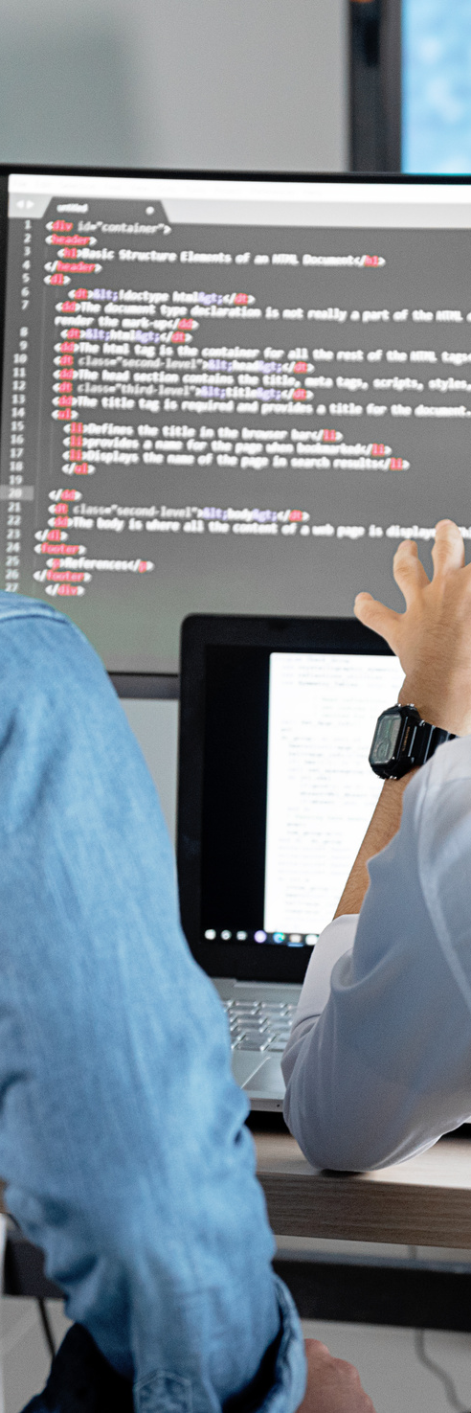
Data-driven
DigiNote utilizes AI's powerful Optical Character Recognition (OCR) technology to accurately analyze and convert handwritten text into digital text formats.
This data-driven approach using appropriate datasets ensures high accuracy and reliability in the conversion process, making it a reliable tool for individuals, students, researchers, professionals, and anyone who deals with handwritten text on a regular basis.
By providing useful text conversion, DigiNote enables users to effectively digitize their handwritten text, and increase work productivity and efficiency.
21
Data-driven

Slide 8
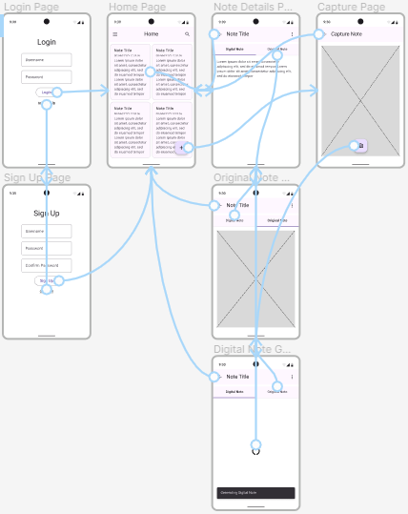
Figma
Early
Prototype
15

Slide 9

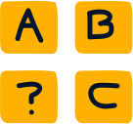

Existing Result
In terms of methods to produce OCR model, there are few key findings by existing studies approach to similar problem such as :
More designed to recognize per words instead of sentences
Focused on particular language
Low Accuracy
when it comes to OCR model performance
Focused on specific
handwriting styles
04
Existing Result

Slide 10
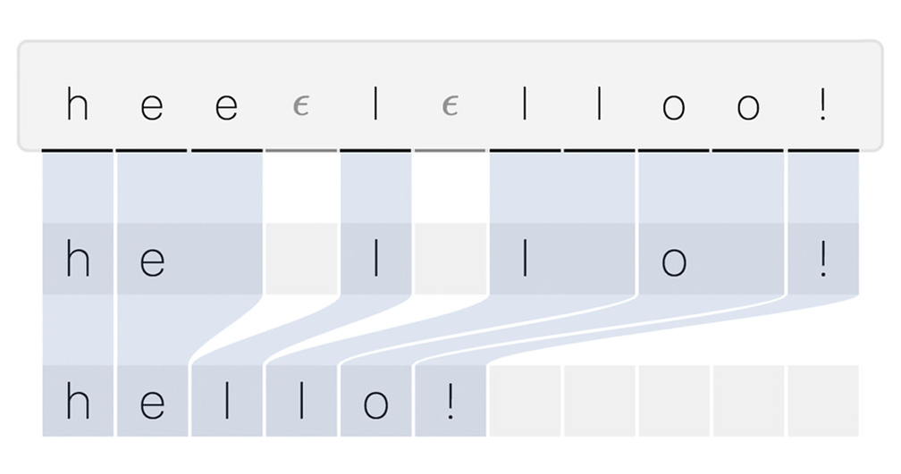
Implementation/Improvement and reasoning
Machine Learning Aspect
Implementing CTC loss function to the OCR model instead of existing regular CNN/RNN model because of its ability to handle variable-length sequence-to-sequence mapping.
Which models can eliminate the need for explicit alignment, and learn to map complex input images to their corresponding textual representations.
05

Slide 11
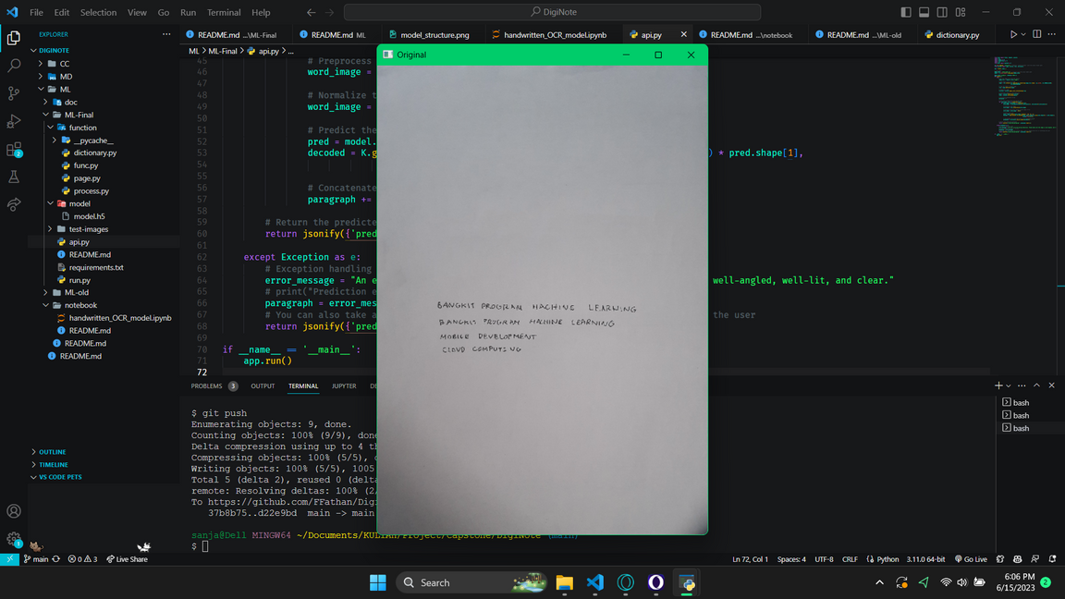
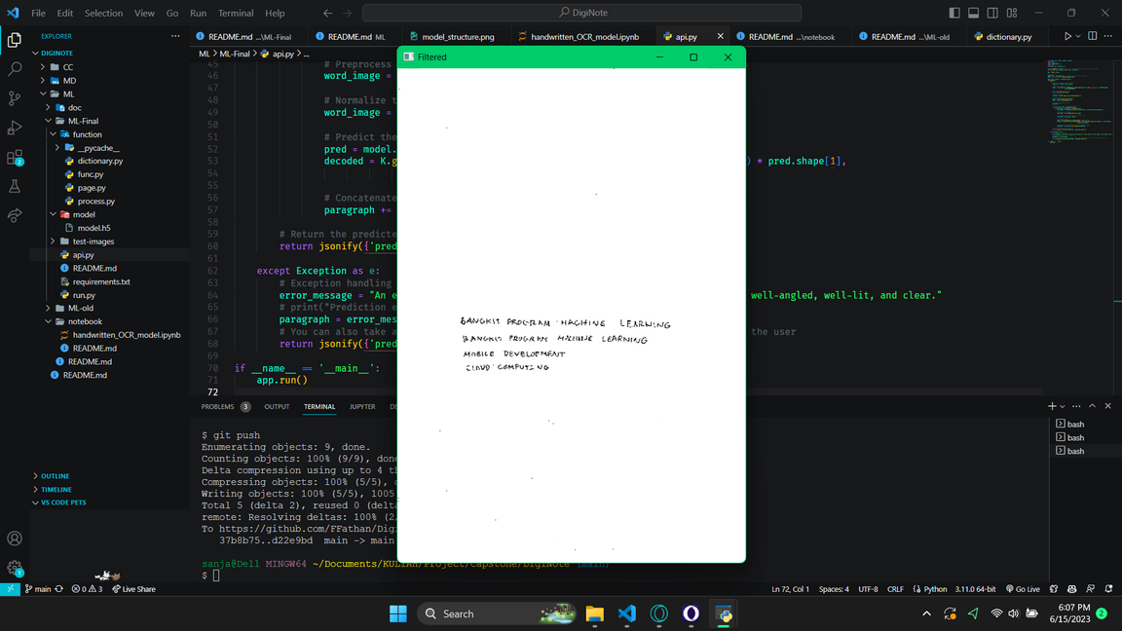
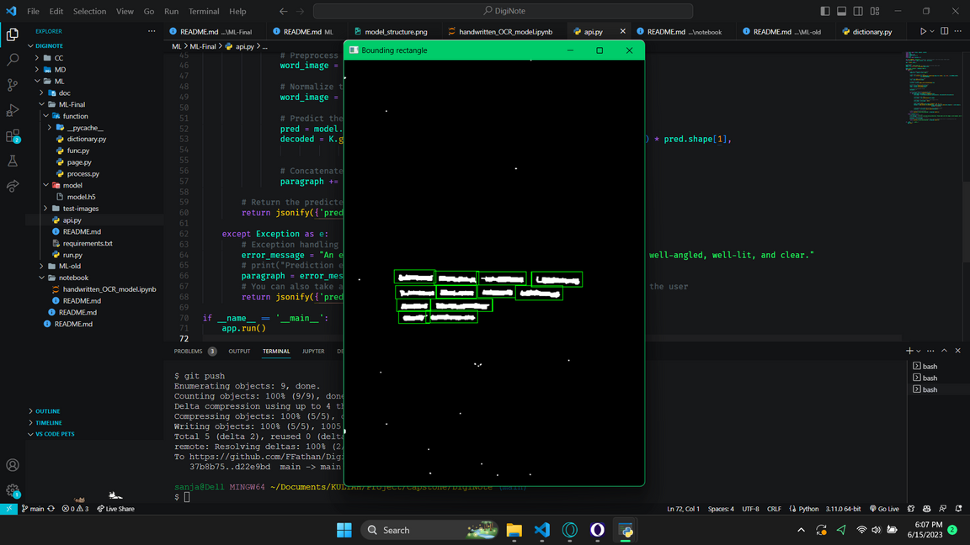
Implementation/Improvement and reasoning
Machine Learning Aspect
Implemented some pre-processing functions for the input images through few steps before data feeded to the model.
Page Detection
Apply Filter
Word Detection
06

Slide 12
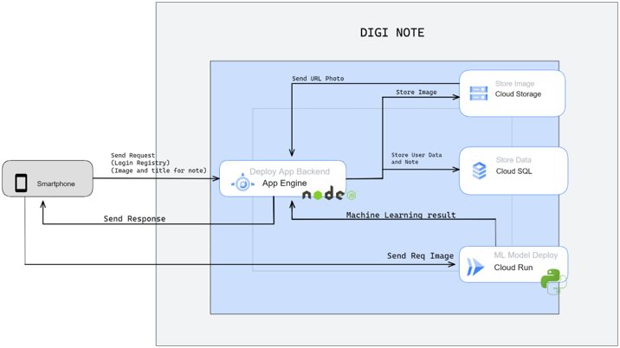
Cloud Environment
14

Slide 13
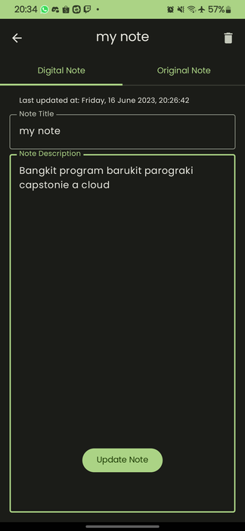
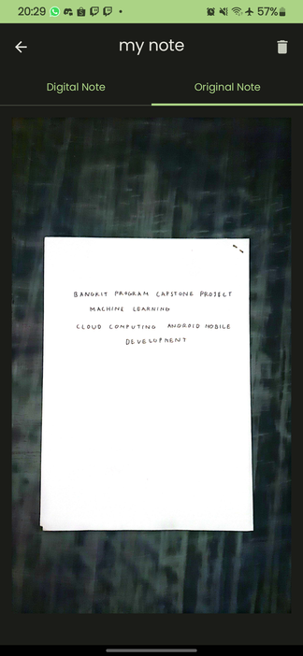
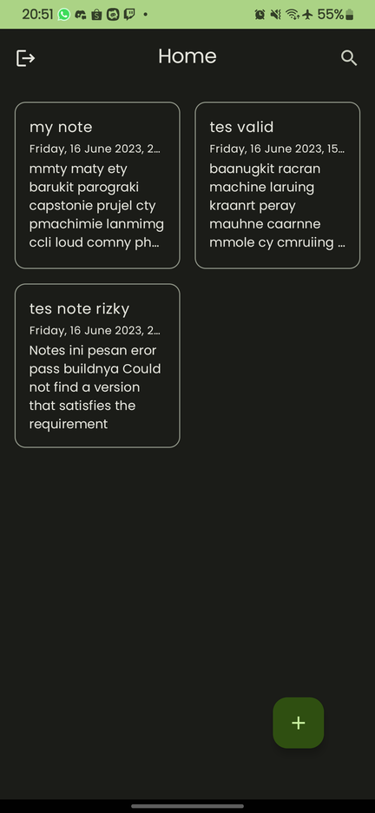
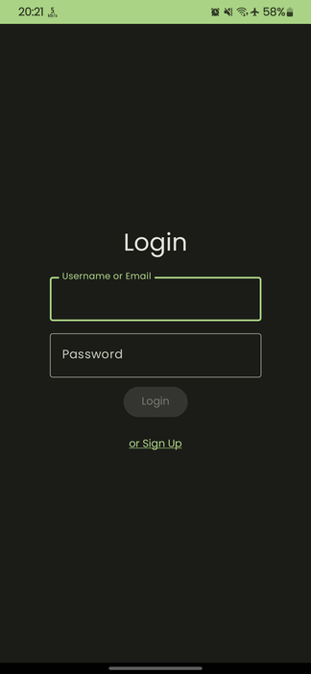
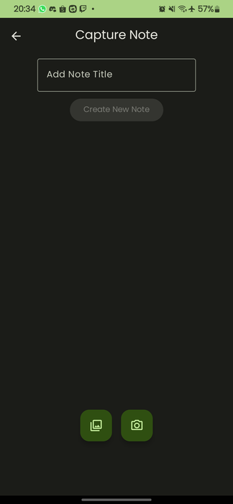
App Overview
VIEW ORIGINAL NOTE
NOTE EDITING
NOTE CAPTURE
LOGIN/
SIGNUP
08

Slide 14







DigiNote Deployment
Tools
13

Slide 15
Documentation
FOR FULL DOCUMENTATION OF OUR PROJECT CAN BE ACESSED AT
GITHUB.COM/FFATHAN/DIGINOTE
09

